Slide 2
References
Sentence-BERT: Sentence Embeddings using Siamese BERT-Networks , Nils Reimers and Iryna Gurevych.

Slide 3
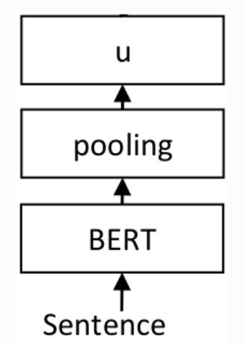
Sentence-BERT: Sentence Embeddings using Siamese BERT-Networks

Slide 4
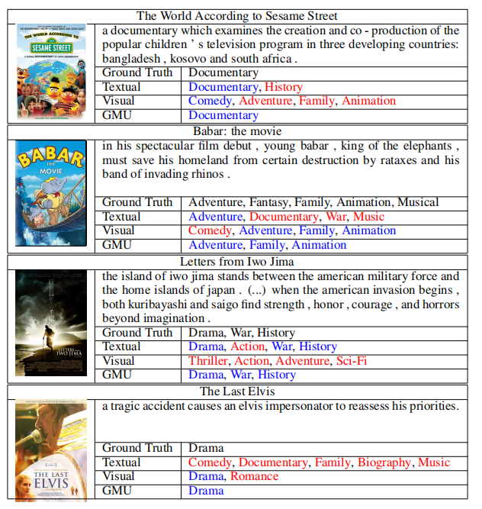
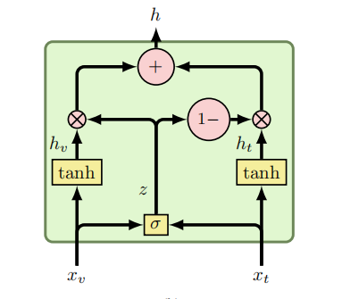
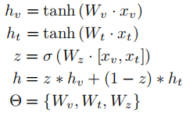
GATED MULTIMODAL UNITS FOR INFORMATION FUSION
https://arxiv.org/pdf/1702.01992.pdf

